Slide 1
Online Examination System(Examsphere)
Fusion Five

Slide 2
Online Examination System
About our Team
Team Name: Fusion five
Project Title: Online Examination System
Course: SIC Coding & Programming
College :RAYAT BAHRA UNIVERSITY,KHARAR(MOHALI)
Batch Code :25037
Team Members & Role:
Ms. ARUSHI KAUSHAL(Team leader)
Mr. Furkan Fayaz(Presentation & Demo)
Mr. Aryan (Data Lead)
Ms. Anjali Sharma(Model Builder)
Mr. Anmol Singh(Research & Testing)

Slide 3
Online Examination System
Problem Statement
The current manual (pen-and-paper) examination system is inefficient and prone
to errors. Key issues include:
High Costs: Large expenses for paper, printing, and logistics.
Time Delays: Grading and result generation take weeks or months.
Security Risks: High chance of question paper leakage and physical tampering.
Human Error: Mistakes in manual marking and data entry for results.

Slide 4
Online Examination System
Objective of the Project
Main Goals: To provide a scalable, tamper-proof platform that automates assessment while
ensuring high security and integrity through user authentication.
Expected Outcomes:
Automated Evaluation: The system will instantly grade objective tests, eliminating human
error and manual labor.
Enhanced Security: Features like randomized question sets and timed sessions will prevent cheating
and unauthorized access.
Accessibility: Students can securely take examinations from any location, reducing the need for
physical infrastructure.

Slide 5
Online Examination System
Proposed Solution
The proposed solution is to develop a web-based Online Examination System
that automates the entire examination process, making it more efficient, secure,
and user-friendly. The system will reduce manual work and provide a reliable platform
for conducting exams online.

Slide 6
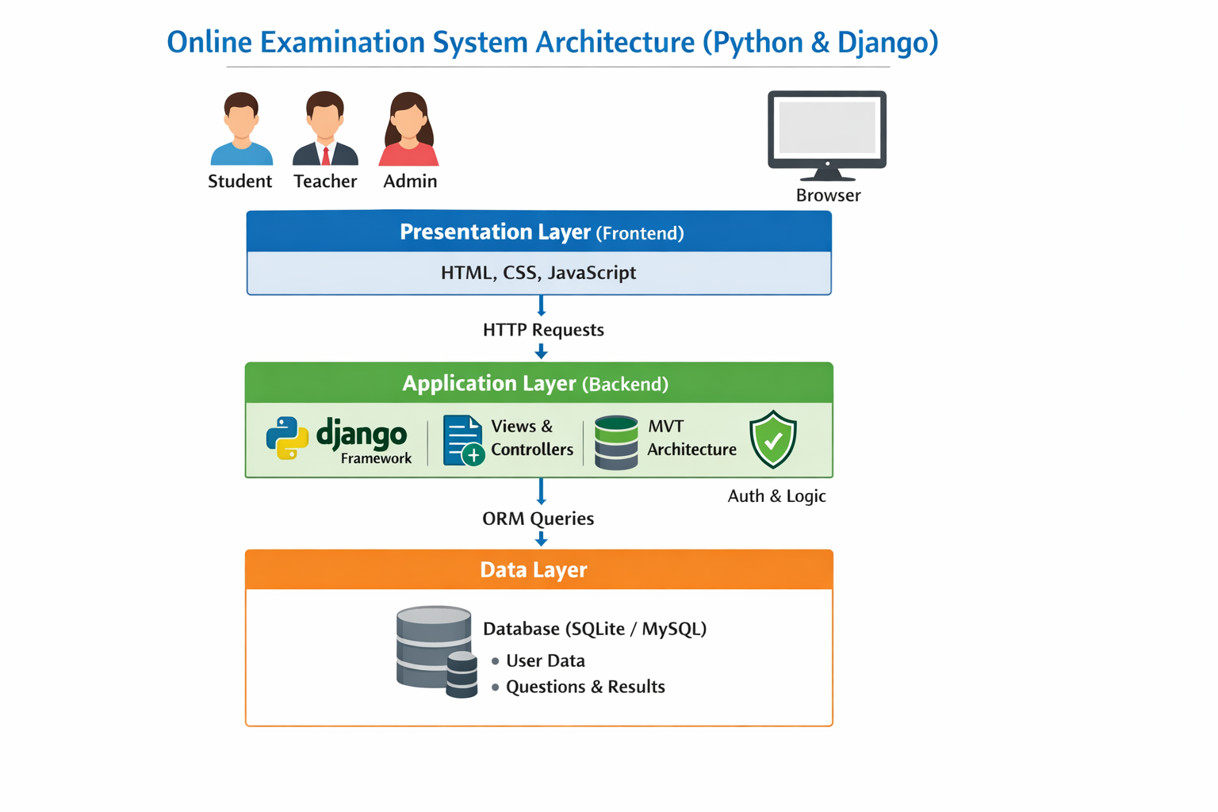
Online Examination System
System Architecture / Flow Diagram
Examination System
n System

Slide 7
Online Examination System
Tools, Technologies & Libraries
Programming Language – Python
We have used Python as the main programming language.
Web Framework – Django to develop the web application.
Django manages:
  User authentication (Student, Teacher, Admin)
  Database handling
  Form processing
  URL routing
Frontend Technologies – HTML, CSS, JavaScript
Database – SQLite (default Django database)
We used SQLite for storing data.
It stores: User details, Questions , Answers ,Results
Development Tools
VS Code– For coding
Git – For version control
Browser – For testing (Chrome/Edge)

Slide 8
Online Examination System
Dataset Description
The dataset used in our project is stored in a relational database (SQLite) and is managed using Django ORM. It contains structured data related to users, exams, questions, and results
User Dataset:This table stores information about all system users like name , password, role (Student / Teacher / Admin)
Student Dataset:Student ID, Attempt Status
Teacher Dataset:Teacher ID, Subject, Department
Exam Dataset:Exam Title, Subject, Total Marks
Question Dataset: Question Text, Option A, B, C, D, Correct Answer

Slide 9
Online Examination System
Methodology / Implementation Steps
1. Coding Logic
Users log in based on role (Admin/Teacher/Student).
Teacher creates exams and adds questions..
System saves answers automatically.
Answers are evaluated and result is generated
2. Algorithm Used
Authentication Algorithm (for login)
Evaluation Algorithm (for scoring)
Role-Based Access Control (for security)
3. Flow of Code Modules
User Module: Login/registration
Exam Module: Create and manage exams
Question Module: Store questions
Submission Module: Save student answers
Evaluation Module: Check answers
Result Module: Display results
User Module → Exam Module → Question Module → Submission Module → Evaluation Module → Result Module

Slide 10
Online Examination System
Results & Performance
Result / Final Outcome:
Developed a secure online exam system.
Automated exam and result process.
Reduced manual work.
Key Findings:
. Saves time and improves accuracy.
Easy to manage exams online.
Secure and reliable system.
Challenges
User authentication
Time management
Backend integration
Future Scope
Mobile app
Online proctoring
Cloud deployment
Features to Add
Auto-save
Random questions
Performance reports

Slide 11

Thank You
Open for questions
Samsung Innovation Campus

